Slide 1
The Office of Exceptional Student Education
Back to School Parent Engagement Session
Wednesday, August 23, 2023
Dr. Nikolai P. Vitti, Superintendent
Nidia Ashby, Chief of Schools
Lohren Nzoma, Assistant Superintendent
Michelle DeJaeger, Executive Director

Slide 2
Welcome & Greetings

Slide 3
AGENDA
Welcome & Greetings
Programs & Curriculum Overview
Special Education Evaluation Process Overview
The Individualized Education Program
What is LRE?
Assistive Technology
Special Olympics
Four Functions of Behavior
Frequently Asked Questions
ESE Website & Parent Resources
Questions & Comments
ESE Contact Information

Slide 4
Programs &
Curriculum Overview

Slide 5
Specialized Programs
DPSCD offers a full continuum of specialized programs designed to meet the unique needs of students with exceptionalities. Programs are individualized for each student and are based on their areas of strength and identified needs. Options for programming are discussed and determined by IEP teams.
District ESE programs include:
Resource Program
Emotional Impairment Program
Day Treatment Program
Mild Cognitive Impairment Program
Moderate Cognitive Impairment Program
Severe Cognitive Impairment Program
Severe Multiple Impairment Program
Physical or Other Health Impairment Program
Dual Diagnosed Program
Postsecondary Programs
Deaf or Hard of Hearing Program
Homebound - Hospitalized Program
Visual Impairment Program
Early Childhood Special Education Program
Early Intervention – Birth to 3 Services
Autism Spectrum Disorder Program

Slide 6
Curriculum Overview
Students with exceptionalities whose IEP includes special education programming may receive specially designed instruction aligned to Michigan’s Common Core State Standards and/or Michigan’s Common Core Essential Elements. This determination is made by the student’s IEP team and is aligned to factors including, but not limited to:
How the student’s disability affects their involvement and progress in the general education curriculum
The state assessment taken by the student, MSTEP or MI-ACCESS
The student’s course of study, as identified in the IEP
Exceptional Student Education (ESE) has adopted and implemented instructional content aligned to Michigan’s Common Core Essential Elements for students who it has been determined appropriate. ESE programs offering instructional content aligned to the essential elementals include:
Mild Cognitive Impairment Program, Grades K-8: Voyager Passport & Vmath
Mild Cognitive Impairment Program, Grades 9-12:
Moderate Cognitive Impairment, Severe Cognitive Impairment, & Severe Multiple Impairment programs: Attainment
Autism Spectrum Disorder Program: Styer Fitzgerald & n2y

Slide 7
Special Education Evaluation Process Overview

Slide 8
Special Education Evaluation Process Overview
Child Find
Districts must have in effect policies and procedures to ensure that all children with disabilities are identified, located, and evaluated.
Request for Initial Evaluation
Either a parent of an enrolled student or the District may request an initial
evaluation when a student is suspected of having a disability. Requests for
an initial evaluation are submitted to the school principal. When a
request is made verbally, the school will support the parent in
documenting this request. A request to evaluate may be
made at any time.

Slide 9
Special Education Evaluation Process Overview
Within 10 school days from the receipt of the request to evaluate, following steps will take place:
The school-based evaluation team (SBET) will complete a comprehensive review of the student’s educational record and all other relevant data, including parent input. At the conclusion of this review, a determination will be made by the team as to whether the request to evaluate will move forward or will be denied. If denied, the parent will receive notice in writing of the denial and a full explanation as to the reason the request to evaluate was denied.
If the request moves forward the SBET will conduct a Review of Existing Evaluation Data (REED), to which the parent is invited to participate and the parent’s written consent to evaluate will be requested.
The REED process may be used to determine what evaluations might be necessary to ensure a comprehensive evaluation in all areas of suspected disabilities.

Slide 10
Special Education Evaluation Process Overview
Once parental consent has been received for the special education evaluation, the SBET has 30 school days to complete a full and individual evaluation in all areas related to the suspected disability, convene the IEP team meeting, and provide the District’s offer of a Free and Appropriate Public Education. Evaluations conducted may include, but are not limited to (if appropriate):
health
vision
hearing
social and emotional status
general intelligence
academic performance
communication skills
motor abilities
Michigan Department of Education Guidance for Timeline for Initial Evaluations

Slide 11
The Individualized Education Program

Slide 12
The Individualized Education Program
Individualized Education Program (IEP): An IEP is a written document for students with exceptionalities ages 3 through 25 that outlines the student’s educational needs and goals and the programs and services a district will provide to help the student make educational progress.
IEPs are written by the IEP team at an IEP team meeting. Parents are critical members of IEP teams. The IEP is reviewed at minimum once per year.
The IEP must:
address the unique needs of the student that result from the student’s disability
ensure access of the student to the general education curriculum, so the student can meet the educational standards that apply to all students.
advance appropriately towards attaining annual goals.
be involved in and make progress in the general curriculum and participate in extracurricular and other non-academic activities.
be educated and participate with other student with disabilities and nondisabled students. 34 CFR §300.320(a)(4)

Slide 13
The Individualized Education Program
The IEP has critical components designed to support the individual areas of strengths and identified needs of students with exceptionalities. These components should be based on current data and other relevant information, including parent input, specific to each student. When an IEP Team determines special education programs and services, the team must review and align the following IEP components:
Major areas of the IEP include:
Present level of academic achievement and functional performance (PLAAFP)
Secondary transitions consideration
Supplementary aids and services
Annual goals and objectives

Slide 14
What is LRE?

Slide 15
Least Restrictive Environment (LRE)
Students must be placed in the general education setting to the greatest extent appropriate and receive supports and services as determined by the IEP team.
When a student is not able to make satisfactory progress towards their IEP goals in the general education environment with supplementary aids and services, the IEP team may consider an educational placement for the student outside of this environment.

Slide 16
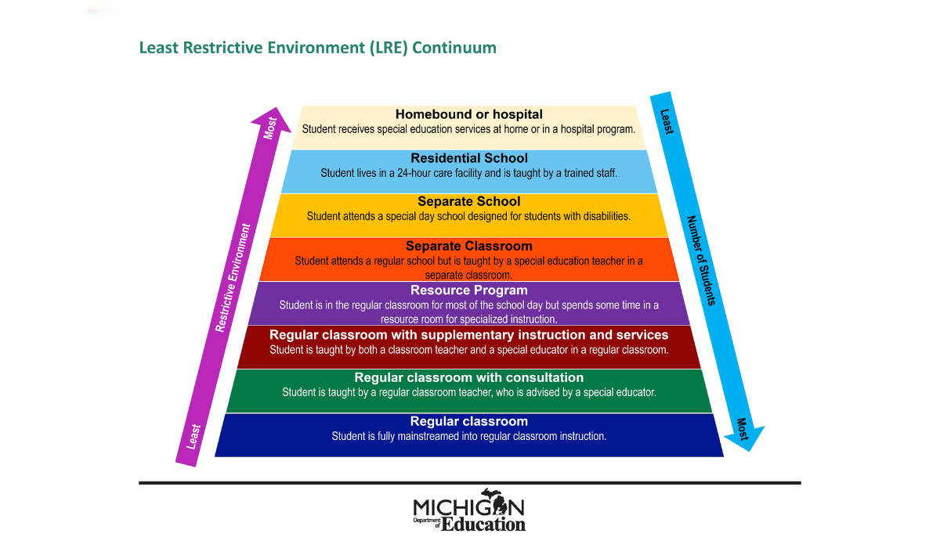
Least Restrictive Environment (LRE)

Slide 17
Assistive Technology

Slide 18
Assistive Technology
Assistive Technology (AT):
This term means any item, piece of equipment, or product system, whether acquired commercially off the shelf, modified, or customized, that is used to increase, maintain, or improve functional capabilities of a child with a disability. Exception – AT does not include a medical device that is surgically implanted, or the replacement of such device.
AT devices and services must be considered for all students with exceptionalities. Consideration is made by the IEP team. When it is determined a student requires AT, the IEP team explores a range of AT devices (tools), and services, or seeks assistance from an ESE AT coach.

Slide 19
Examples of Assistive Technology

Slide 20
Four Functions of Behavior

Slide 21
Four Functions of Behavior
All behaviors exhibited by children are based on a specific need or want at that moment in time. The functions of these behaviors fall into on of these four specific categories:
Sensory Stimulation
Escape Environment or Task
Attention Seeking
Tangible Items
When we understand the motivation for the student’s behavior, it gives us insight into what they need. That insight helps drive the intervention strategy that is used to help meet the student’s needs and redirect the behavior to something healthier and more productive.
https://www.theintentionaliep.com/functions-of-behavior/

Slide 22
Four Functions of Behavior
Sensory Stimulation
Children who are seeking sensory stimulation are often seen exhibiting behaviors that are pleasurable for them. For example, they may be seen twirling their hair around their fingers, humming, or picking at their nails or skin. While not everyone may find these activities pleasurable, for the student, they are soothing and provide pleasure in the moment. Examples of Interventions for Sensory Stimulation include, but are not limited to:
Offer sensory-based experiences in the classroom through the use of sensory bins or a sensory wall
Offer musical reinforcement for students who need auditory stimulation
Provide tactile stimulation through the use of mini-trampolines or rocking chairs
Escape from Environment or Task
For those children who are trying to escape from an environment or task, their behavior is usually easy to classify. They can be found hiding, running away, avoiding people and situations, or avoiding discomfort. Examples of Interventions for Escape Behavior include, but are not limited to:
Provide frequent breaks.
Include the child’s likes or interests in the assignment or task.
Modify how the assignment can be completed Create and stick to a schedule to provide predictability
Offer choice

Slide 23
Four Functions of Behavior
Attention-Seeking
Not all attention-seeking behavior is negative, but there are times when it is used in an inappropriate manner. Some examples of behavior that may need intervention be observed as being excessively loud, whining, waving arms to get attention, and more. Examples of Interventions for Attention-Seeking Behavior include, but are not limited to:
Increase proximity to the child by moving closer to him
Rearrange seating so he is closer to the teacher/front of the classroom
Provide more frequent positive interactions
Tangible Items
Students who want a particular item or to participate in an activity may display inappropriate behavior to get what they want. These tangible items or activities are things that they find pleasurable and not being able to have them or participate in them can lead to disruptive behavior. Examples of negative behavior might be throwing a tantrum to get an object or stealing an object from a person or store. Examples of Interventions for Attention-Seeking Behavior include, but are not limited to:
Allow the child access to highly desired items.
Provide preferred activities between activities that are highly preferred and highly non-preferred.

Slide 24
Special Olympics

Slide 25
Special Olympics Unified Champion Schools
Social inclusion through intentionally planned and implemented activities
Systems-wide change with sports as the foundation
Inclusive sports, inclusive youth leadership opportunities, and whole school engagement
Socially inclusive school that supports and engages
all learners

Slide 26
Special Olympics Unified Champion Schools
Special Olympics Unified Champion Schools promotes:
Social inclusion through intentionally planned and implemented activities
Systems-wide change with sports as the foundation
Inclusive sports & youth leadership opportunities, & whole school engagement
Socially inclusive schools that supports and engages all learners
All schools are invited to participate in seasonally offered sports opportunities.
UNIFIED CHAMPION SPORTS Peer to Peer | INCLUSION ACTIVITIES
Bocce | Lunch Buddies
Flag Football | Youth Action Committee
Basketball | Recess Games
Track & Field | Healthy Cooking
Volleyball | Family Events
Aquatics | E-Sports
Golf | Reading Club

Slide 27
Frequently Asked Questions

Slide 28
Frequently Asked Questions
Who should I contact if I have questions about transportation?
2. My child has been suspended from school for her behavior. With whom should I speak about this, and is there anything we can do to support my child with these challenges?
3. How do I enroll my child in DPSCD if he has an IEP?
4. I want my child evaluated for special education. What process should I follow?
5. How can I become more involved with Exceptional Student Education?
6. If I want to enroll my child in a DPSCD school other than our neighborhood school, who should I contact & what do I need to know?

Slide 29
ESE Website & Parent Resources

Slide 30
ESE Website and Parent Resources
DPSCD Exceptional Student Education: https://www.detroitk12.org/Page/7160
Family Matters: https://www.michigan.gov/mde/services/special-education/parent-resources/family-matters
Michigan Alliance for Families: www.michiganallianceforfamilies.org

Slide 31
Questions & Comments

Slide 32
ESE Contact Information
Lohren Nzoma, Assistant Superintendent
Office: 313-873-7740 Email: lohren.nzoma@detroitk12.org
Michelle DeJaeger, Executive Director
Office: 313-873-7740 Email: michelle.dejaeger@detroitk12.org
Marlene Hunter-Armstrong, Director of Compliance
Office: 313-748-6276 Email: marlene.hunter-armstrong@detroitk12.org
Renee Kidd, Senior Director of Information System Management & ESE Enrollment
Office: 313-748-6443 Email: renee.kidd@detroitk12.org

Slide 33
ESE Cohort Lead Administrators Contact Information
Tanya McClue-Clark, Cohort 1 ESE Lead Administrator
Emails: tanya.mcclue-clark@detroitk12.org
Monique Ellison-Jenkins, Cohort 2 ESE Lead Administrator
Email: monique.ellison-jenkins@detroitk12.org
Sarah Jardin, Cohort 3 ESE Lead Administrator
Email: sarah.jardine@detroitk12.org
Tyra Butler, Cohort 4 ESE Lead Administrator
Email: tyra.butler@detroitk12.org
Donna Payne, Early Childhood ESE Lead Administrator
Email: donna.payne@detroitk12.org

Slide 34
THANK YOU!!!

